Slide 1
Genome assembly and investigation of Hypomesus transpacificus (delta smelt) genome for estimates of effective population sizes and identification of sex-specific markers.
Shannon E.K. Joslin
Thesis Committee Meeting 2021
07 May 2021
(https://github.com/shannonekj/presentations/tree/master/2021_05-thesis_commitee_meeting)
Notes:
First off I want to thank you all for meeting today. Me and my thesis work feel really appreciative there was a time that worked for everyone. I want to give everyone an update on my thesis work. I have about twenty slides and I am primarily looking for feedback on my last aim. So while of course feel free to interrupt me, also please leave a little time for discussing my last aim. You all have been in many more thesis meetings than I have so let me know if that format isn't consistent with the point of these meetings.
Also, I believe I've let all of you know individually but I applied to a position as Yosemite National Park's Wildlife Data Manager and I ended up getting the position. woo hoo! I will be starting that position in July and will be working part time towards finishing my degree from then on.
Anyways, onto my research––I think all of you know by now but just in case any interactions that you've had with me has been wiped from your memory I've been working on the genome assembly and investigation of the delta smelt genome for estimates of effective population size and identification of sex-specific markers.

Slide 2
Overview
AIM #1: Produce a reference genome for delta smelt.
AIM #2: Infer contemporary & historical effective population sizes of delta smelt.
AIM #3: Discover sex-specific markers for sex identification of delta smelt.
Notes:
The first aim of my dissertation work is to produce a high-quality reference genome for delta smelt
My second aim is to estimate contemporary and historical effective population size using temporal data from roughly 25 generations of delta smelt.
My third and last aim is to identify sex-specific markers that can be used to non-invasively (aka genetically) sex wild and captive delta smelt. This is the topic that I'm hoping to glean some advice for

Slide 3
Aim #1: Setup
Aim 1: Assembly Aim 2: N_{E} Aim 3: Sex Marker
hybrid assembly
one male, one female
original experimental design
implemented experimental design
linked reads + hi-c
long reads + linked reads + hi-c + linkage map ++ karyotype
Why/how??
cheaper
recovered linkage loci
collaboration with Delaney lab
Notes:
For my first aim , the genome assembly, I carried out two hybrid assemblies––hybrid assemblies assemble genomes using multiple types of sequencing data. I gathered data and performed one female and one male delta smelt assembly.
Originally, I was intending to only use 10X Genomics linked-read sequencing and Phase Genomics hi-c sequencing but I struck a bit of luck and three things happened.
1. the price of PacBio long read sequencing dropped dramatically a few years ago
2. we recovered the loci sequences from a linkage map study by Lew et al 2015
3. I collaborated with the Delaney lab to karyotype delta smelt for a non-sequence based chromosome number count

Slide 4
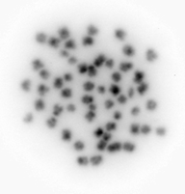
Aim #1: karyotype
Aim 1: Assembly Aim 2: N_{E} Aim 3: Sex Marker
2 experiments
used juvenile fish
found 2n = 56
image is too low res to say anything about sex chromosomes or chromosome composition
<- useful!
Notes:
We ran two separate experiments to karyotype the fish. The first ended up being a bit of a trial run to get the process of selecting and processing individuals down as there were three of us and we all provided different functions within the experiment. We used juvenile fish that were about 100 days post hatch, so they were still growing. Upon dissection we sexed the fish and separated the head kidney (which would have cells dividing at a rapid rate) and we separated the sampled tissue into male and female pools. Unfortunately, we didn't find many cells with usable chromosomes that were suspended at the correct step of mitosis (the fish are small), and this was the best image we captured. Fortunately, it does tell us 2n=56 but cannot give any further information like chromosome composition or tell if there is the presence of a sex chromosome.

Slide 5
Aim #1: Implementation & Results
Aim 1: Assembly Aim 2: N_{E} Aim 3: Sex Marker
Sequencing
Initial assembly
Purge duplicate haplotigs
Add in sequencing technology
More sequencing
Incorporate linkage map information
Scaffold
Scaffold
Sample +
HMW DNA extraction
long reads
(PacBio)
IPA
linked reads
(10X)
scaff10x
hi-c
(Phase)
SALSA
chromonomer
purge_dups
male assembly stats
female assembly stats
N50 | 12,200,365
L50 | 15
n_contigs | 549
asm_length | 472,157,411
BUSCO | 88.40%
N50 | 14,850,352
L50 | 13
n_contigs | 376
asm_length | 437,273,953
BUSCO | 89.30%
Genome
!
= software
= sequencing technology
Notes:
While the karyotyping study was happening I was also working to assemble the genome of delta smelt. This slide gives a rough idea of the steps I took to complete the assemblies.
First, I sampled the fish and either brought the sampled tissue to the DNA Technologies Core for extraction and sequencing, or I shipped sampled tissue to Phase for extraction and hi-c sequencing.
Once I received the long-read sequencing data I ran a primary assembly using just the long reads.
I then purged the assembly of duplicated haplotigs and scaffolded the assembly using the semi-long-range information from the linked-reads.
Then I further scaffolded the linked and long read assembly using the ultra long-range information from the hi-c data.
After, I used the linkage map loci to anchor the by now very large scaffolds into chromosome level scaffolds.
The BUSCO statistics of the male and female assemblies were fairly comparable. But female assembly has air parenthesis better N50 and L50 statistics while the male assembly length is slightly longer. This could be due to the presence of a male chromosome but alas, perhaps let's hold off on this until aim 3.

Slide 6
Aim #1: next steps…
Aim 1: Assembly Aim 2: N_{E} Aim 3: Sex Marker
manually curate according to Howe et al. (2021)
submit to NCBI
write up for paper
Notes:
Next I will be manually curating the assembly according to a newly published paper from Howe et al (2021) which has many members of the Vertebrate Genome Project on the author line and has been useful in bettering or finalizing their assemblies.
Once I clean up the assemblies a bit I will upload them to NCBI
Then write everything up.

Slide 7
Aim #2: Setup
Aim 1: Assembly Aim 2: N_{E} Aim 3: Sex Marker
2945 individuals
Cohorts: 1993 – 2020
Historical N_{E} = Pi & Watterson’s
Contemporary N_{E} = linkage disequilibrium & temporal
Notes:
For my second aim of inferring the effective population size of delta smelt, I ran a preliminary analysis while I was carrying out the genome assembly. The dataset for this portion of my project consists of 2945 individuals spanning about 25 birth years. As a reminder delta smelt have an annual life cycle so each year also corresponds to a different generation.
I estimated historical Ne using theta pi and Watterson's theta, and estimated contemporary Ne using a linkage disequilibrium and temporal method
My initial analysis estimated Ne using a RAD-sequencing based "reference assembly" I'm now reimplementing the analysis I previously performed using my shiny new genome.

Slide 8

Aim #2: Thetas depicted
Aim 1: Assembly Aim 2: N_{E} Aim 3: Sex Marker
Watterson’s Theta Number of segregating sites
Theta Pi
Pairwise nucleotide diversity
vs
Segregating sites
Sample size
$$θ=4N_{e}μ$$
Notes:
Just a brief reminder for anyone that hasn't thought about effective population size in awhile or ever.
Watteron's theta is the number of segregating sites in a genome and theta pi is the pairwise nucleotide diversity between samples. Thetas can be input into the equation theta equals 4 Ne mew, where mew is the mutation rate and Ne is the effective population size.

Slide 9
Aim #2: Trial run
Aim 1: Assembly Aim 2: N_{E} Aim 3: Sex Marker
historical
used RADseq based reference assembly
Notes:
This is a plot of Watterson's theta and theta pi estimated for each generation using the RAD seq reference genome. You can see that it seems both are decreasing but Watterson's theta is inflated compared to theta pi.

Slide 10
Aim #2: Preliminary result (w new asm)
Aim 1: Assembly Aim 2: N_{E} Aim 3: Sex Marker
historical
needs further filtering
Notes:
Here I've rerun the same analysis with the new genome and we see the same overall decrease in theta but with a smaller difference between Watterson's and pi. I'm still refining the filtration parameters for this estimate as there is both some variability, and Watterson's continues to be inflated from pi

Slide 11
Aim #2: Trial run (used previous RAD asm)
Aim 1: Assembly Aim 2: N_{E} Aim 3: Sex Marker
contemporary
used RADseq based reference assembly
rerunning using new genome
Notes:
Next, I ran a contemporary temporal analysis on the data using the old RADseq reference assembly and got highly variable estimates of Ne depending on which year was used as generation 0. You can see that for the last three years the estimates seem to be less variable and show a downward trend. Which could be from the effective population size decreasing to a number that can be more accurately estimated and having narrower confidence intervals.

Slide 12
Aim #2: Next steps
Aim 1: Assembly Aim 2: N_{E} Aim 3: Sex Marker
currently re-running analysis using new reference genome
Notes:
My next step for this aim is to re-run the temporal analysis as well as refine the filtration parameters for the long-term estimates.

Slide 13
Aim #3: Analyses
Aim 1: Assembly Aim 2: N_{E} Aim 3: Sex Marker
depth analysis
GWAS
k-mer analysis
Notes:
For my final aim, I am seeking to identify sex specific markers in delta smelt. So far, we have run a depth analysis, a genome wide association study and performed a k-mer analysis.

Slide 14
Aim #3: Depth analysis
Aim 1: Assembly Aim 2: N_{E} Aim 3: Sex Marker
compared M & F RAD alignment depths between sexes
2 experiments
aligned to M reference
aligned to F reference
…found no differences
Notes:
For the depth analysis I looked at the difference of alignment depth between male and female individuals at every location in the genome. I performed two of these experiments... one using the male reference genome and another using the female reference genome. The thought was that if one sex had an area of the genome unique to that sex, there would be high and consistent coverage in that sex and shallow or no coverage in the other sex. I found no large areas that corresponded to an inflation of any one particular sex having higher depth of coverage.

Slide 15
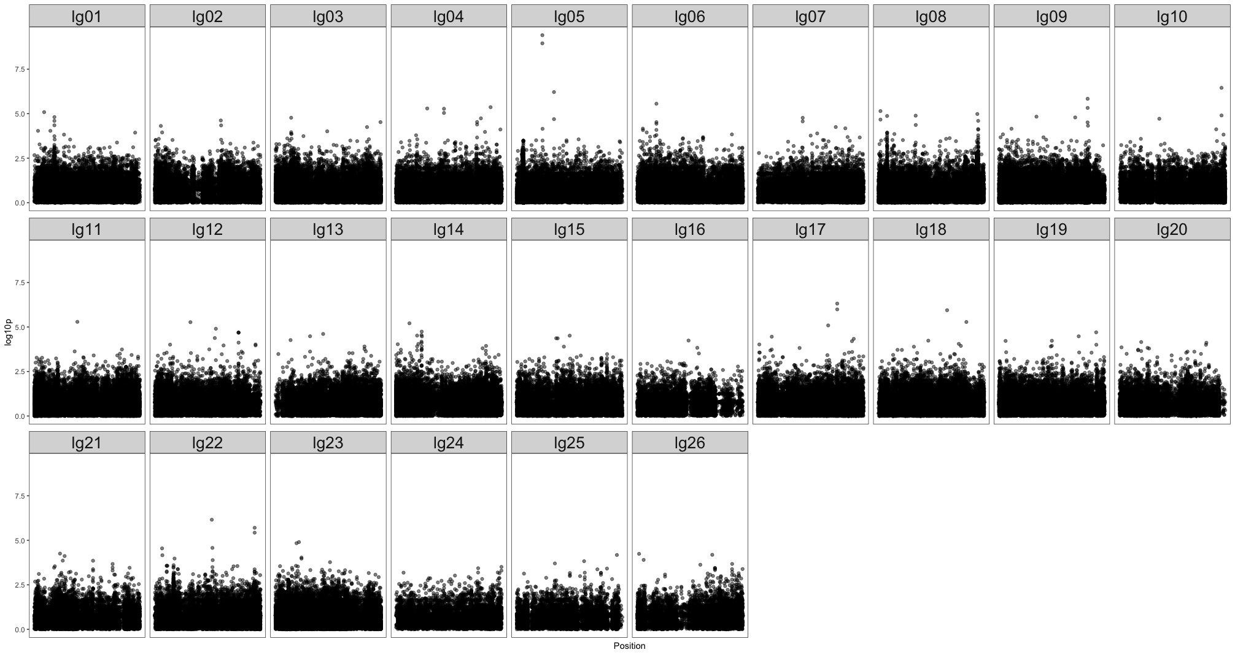
Aim #3: Genome wide association study
Aim 1: Assembly Aim 2: N_{E} Aim 3: Sex Marker
but the genotypes for these two
markers don’t segregate with sex…
Notes:
Next, I performed a genome wide association study using binary case and controls (so if a fish were a male it would be a case and if it were a female it would be a control). I also performed two of these experiments, one using the male genome and another using the female genome. I did not find any significant associations when performing a GWAS using the female reference genome. However, I found two significant SNPs on chromosome 5 using the male reference genome. Unfortunately, these SNPs do not segregate with sex.

Slide 16
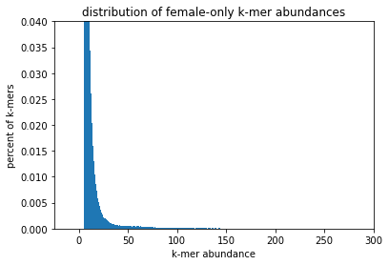
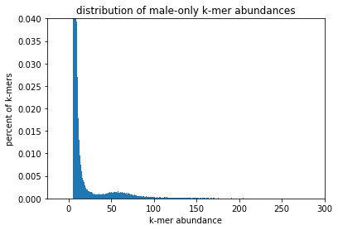
Aim #3: k-mer analysis
Aim 1: Assembly Aim 2: N_{E} Aim 3: Sex Marker
made signature of kmers belonging to each sex
filtered for low abundance kmers (minAb > 5)
Notes:
Lastly, at least for now, in collaboration with Titus Brown, we performed a kmer analysis to try to find sex specific kmers in delta smelt. This analysis was performed with 10X sequencing data from one male and one female individual.
First, we made signatures of all kmers belonging to each sex and scaled for one kmer every 1000bp
Then filtered out low abundance kmers and kept anything with a kmer count above an abundacnce threshold of 5

Slide 17
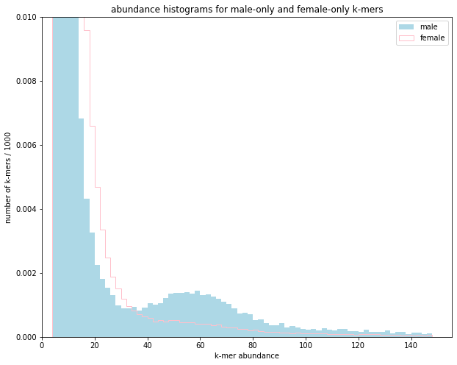
Aim #3: k-mer analysis
Aim 1: Assembly Aim 2: N_{E} Aim 3: Sex Marker
made signature of kmers belonging to each sex
filtered for low abundance kmers (minAb > 5)
compared # of male only, female onle kmers
(found males have more high abund kmers)
Notes:
After we compared the number of male only kmers to the number of female only kmers and found this little hump on the right here.
So of the male only sequences there were more high abundance kmers in males. Intriguing

Slide 18
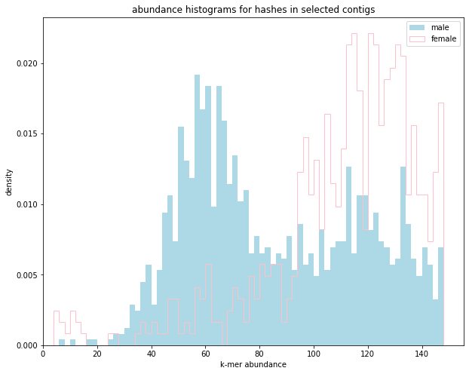
Aim #3: k-mer analysis
Aim 1: Assembly Aim 2: N_{E} Aim 3: Sex Marker
made signature of kmers belonging to each sex
filtered for low abundance kmers (minAb > 5)
compared # of male only, female onle kmers
(found males have more high abund kmers)
extracted contigs with > 5 kmers
looked at kmer abundances in extracted contigs
(male specific peak from abundance of 30-70)
Notes:
After, we extracted contigs that contained at least 5 kmers on them... this was to grab contigs that spanned an area of about 5000 bp or more.
The plot to the right shows a male specific peak around 30-70 which is about half as abundant as the right peak...which could be consistent with a XY sex chromosome situation or at least a large sex specific area.

Slide 19
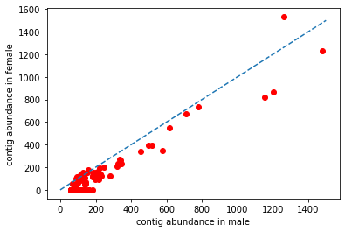
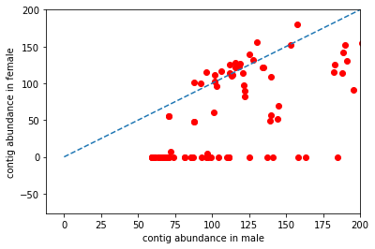
Aim #3: k-mer analysis
Aim 1: Assembly Aim 2: N_{E} Aim 3: Sex Marker
made signature of kmers belonging to each sex
filtered for low abundance kmers (minAb > 5)
compared # of male only, female onle kmers
(found males have more high abund kmers)
extracted contigs with > 5 kmers
looked at kmer abundances in extracted contigs
(male specific peak from abundance of 30-70)
compare contig abundance in M & F
Notes:
Finally, we compared the contig abundance in males and females and plotted those comparisons.
The bottom plot is the same as the top plot but zoomed into that line of zero abundance contigs in females.
So clearly there are contigs that are abundant in males but not in females.

Slide 20
Aim #3: k-mer analysis
Aim 1: Assembly Aim 2: N_{E} Aim 3: Sex Marker
made signature of kmers belonging to each sex
filtered for low abundance kmers (minAb > 5)
compared # of male only, female onle kmers
(found males have more high abund kmers)
extracted contigs with > 5 kmers
looked at kmer abundances in extracted contigs
(male specific peak from abundance of 30-70)
compare contig abundance in M & F
aligned “putative Y” sequences to genome
compared M & F depth at loci
(found no differences)
Notes:
Finally, I aligned these putative Y contigs to the male genome assembly. They align to various regions throughout the genome...none of which being on chromosome 5.
I also took the RAD data that I aligned to the male genome and pulled the alignments that were in the same regions as the putative Y sequences out .
I then compared the depths of the RAD data in the putative Y regions. I found no significant difference of depth of coverage.

Slide 21
Aim #3: next steps…
Aim 1: Assembly Aim 2: N_{E} Aim 3: Sex Marker
acquire shotgun WGS data to further investigate CHR 5
suggestions?
Notes:
I'm hoping acquire some advice on next steps for this portion of my work.
I'm currently thinking acquiring WGS data would be helpful, but it also costs money that I may or may not have.
Additionally, I want to go through my depth analysis scripts again to make sure I'm not miscalculating or organizing the data in a way that doesn't fully represent the true depth differences.
I would also like to look at if there are SNPs in the RAD data on the putative Y sequences

